Slide 1
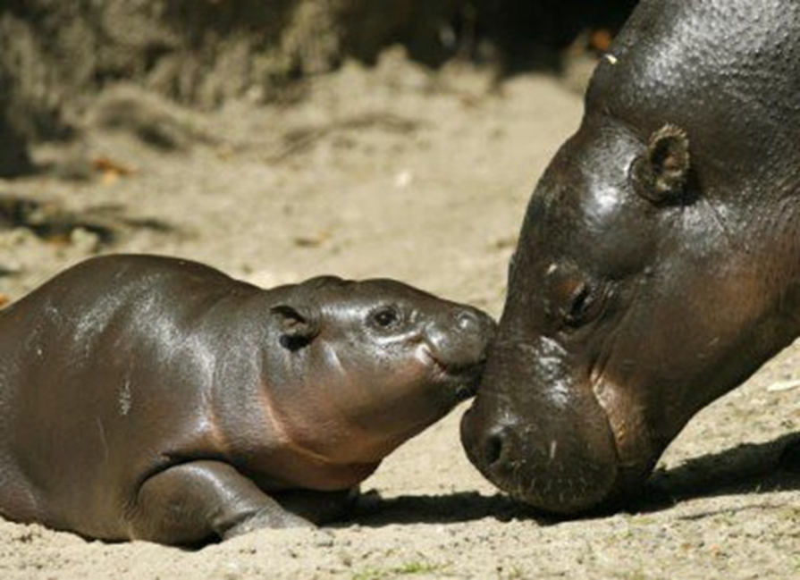
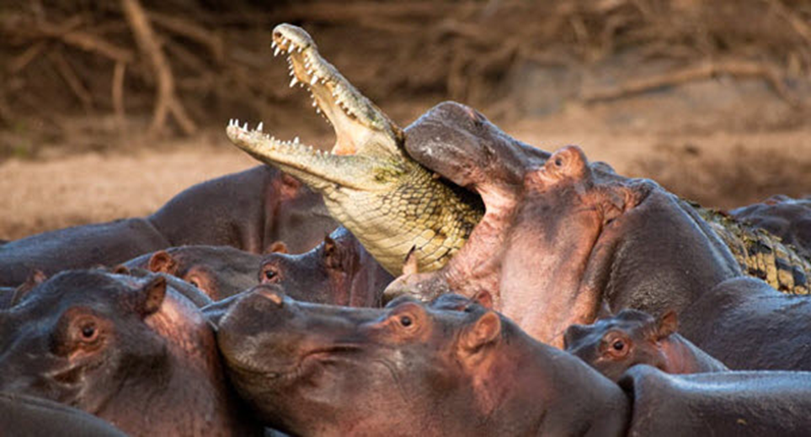
APUSH Writing Skills Document Analysis: HIPPO

Slide 2
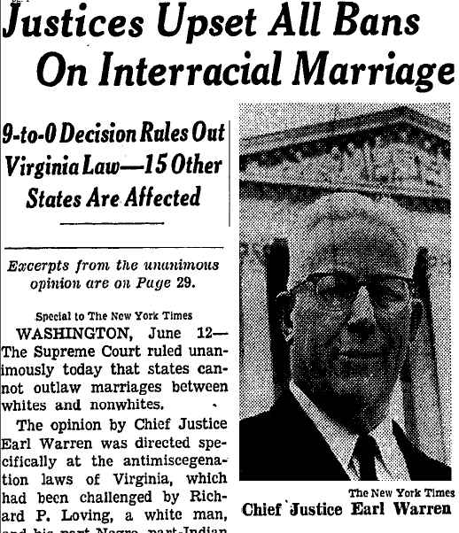
Historical Context
Connecting a document to specific historical events, to specific circumstances of time and place, and/or to broader regional, national, or global processes.
It might also connect the document across time to earlier and later eras, or across space to events happening in different places.
*Look at source line.*

Slide 3
Intended Audience
Explain to the Reader who the author had in mind when he/she created the document.

Slide 4
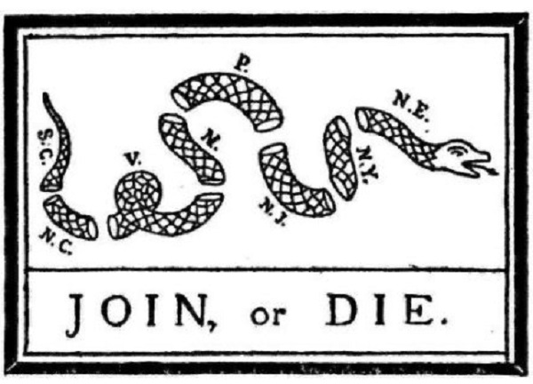
Purpose
Explain to the Reader why was the document created? What was the goal of the author?

Slide 5
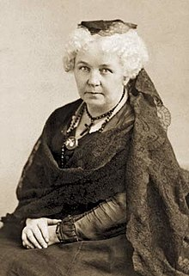
Point of View (POV)
Point of view is the perspective, which shows us the opinion, or feelings, of the author. Examine identity of the author (e.g. race, gender, political affiliation, religion, etc.)
“There can be no true dignity of independence where there is subordination to the absolute will of another, no happiness without freedom.”
- Elizabeth Cady Stanton, Address at Seneca Falls Convention, July 1848

Slide 6
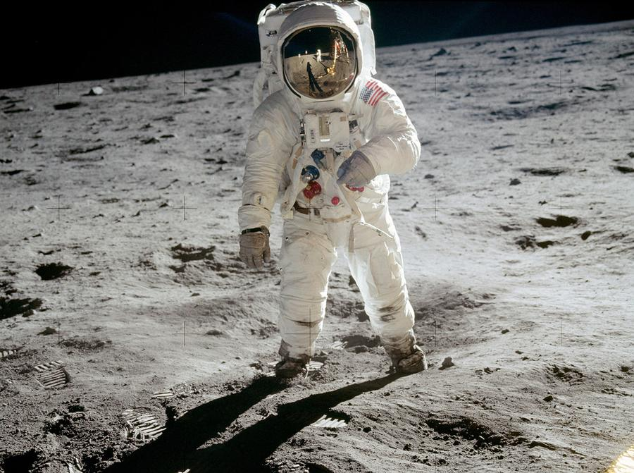
Outside Information
Explain to the Reader outside information that is NOT contained in any of the documents (but is relevant) and that supports your thesis. *Do this FIRST, after you have broken down prompt.*

